Slide 2
TRAFFIC PREDICTION (USING MACHINE LEARNING WITH DATA SCIENCE)
PRESENTED BY:-
1. SAINATH VARMA
2. AAKASH NEELI
3. KRITHI VARIUN
4. SAM NATHAN
5. BANDHAV
6. G.VENKATA DHINESH

Slide 3
OUTLINE
01
02
03
04
05
INTRODUCTION
LITERATURE REVIEW
OBJECTIVES
PROBLEM STATEMENT
PROPOSED METHOD

Slide 4

INTRODUCTION
Almost every driver has dealt with traffic. It occurs from having too many cars on it at once. If
the road doesn’t have space for all of the vehicles, people have to drive slower and closer
together to fit more cars.
Due to the ever increasing usage of private transportation the amount of traffic we
encounter keep increasing day by day. Traffic can lead to problems like pollution,
unproductivity etc.
Traffic prediction is the task of forecasting real-time traffic information based on floating
car data and historical traffic data, such as traffic flow, average traffic speed and traffic
incidents.
01
02
03

Slide 5
04
As of today, different Machine Learning (and specifically deep learning) techniques capable of processing huge amounts of both historic and real-time data are used to forecast traffic flow, density, and speed.
It has the potential to help road users make better travel decisions, alleviate traffic congestion, reduce carbon emissions, and improve traffic operation efficiency
One clear way to tackle this problem is by implementing “traffic volume prediction”.
05
06

Slide 6
LITERATURE REVIEW
AUTHOR &YEAR
PAPER TITLE
PROPOSED METHOD
LIMITATIONS
Mahmuda Akhtar
Sara Moridpour
January 2021
A Review of Traffic Congestion Prediction Using Artificial Intelligence
Using various clustering methods on different datasets mainly collected from stationary and probe sensors
Sensor data cannot capture the dynamic traffic change, frequent change in source makes it complicated to evaluate the flow patterns for probe data and sensor operation may interrupt anytime.
B.Karthika
N.Uma Maheswari
R.Venkatesh
July 2019
A Research of Traffic Prediction using Deep Learning Techniques
Data are collected from different sources and parameter selection is done. The evaluations of the proposed algorithm against metrics (i.e., RMSE, RMS) are used. A prediction is implemented to each data source using a deep learning algorithm. All predictions are fused together to obtain result.
The prediction of traffic data is a challenge owing to short-term (e.g. accidents, constructions) and long-term (e.g. peak, - hour, seasonal or weather) pattern

Slide 7
AUTHOR &YEAR
PAPER TITLE
PROPOSED METHOD
LIMITATIONS
Machine Learning Based Traffic Volume Count Prediction
Profound learning and hereditary calculation is an vital issue in information examination for traffic prediction.
Nishant Patil
Megha Natekar
Ratan Gore
Chandrashekhar Raut
May 2022
Using Python and its various libraries, Lasso regression and Ridge regression
Deep Neural Networks (DNN) like Convolutional Neural Network (CNN), Recurrent Neural Network (RNN), Long Short-Term Memory (LSTM), Restricted Boltzmann Machines (RBM), and Stacked Auto Encoder (SAE). These deep learning models use multiple layers to extract higher level of features from raw input progressively.
The prediction of traffic data is a challenge owing to short-term (e.g. accidents, constructions) and long-term (e.g. peak, - hour, seasonal or weather) pattern
Anirudh Ameya Kashyap
Shravan Raviraj
Ananya Devarakonda
Shamanth RNayak K
Santhosh K V
June 2021
Traffic flow prediction models – A review of deep learning techniques

Slide 8
AUTHOR &YEAR
PAPER TITLE
PROPOSED METHOD
LIMITATIONS
As a traffic flow process is complicated in nature, deep-learning algorithms can represent traffic features without prior knowledge, which has good performance for traffic-flow prediction
The existing NN-based methods for traffic flow prediction usually have only one hidden layer. It is hard to train a deep-layered hierarchical NN with a gradient-based training algorithm
Anand PaulNaveen ChilamkurtiAlfred DanielSeungmin Rho
2017
Intelligent Vehicular Networks and Communications

Slide 9

OBJECTIVE
To create a system that predicts the flow and volume of traffic so that the users can take well informed decisions and plan their travels

Slide 10
Problem Statement
Traffic congestion is a condition in transport that is characterized by slower speeds, longer trip times, and increased vehicular queueing.
When traffic demand is great enough that the interaction between vehicles slows the speed of the traffic stream, this results in some congestion. This leads to a number of problems such as delays, which may result in late arrival for employment, meetings, and education, resulting in lost business, disciplinary action or other personal losses, also blocked traffic may interfere with the passage of emergency vehicles traveling to their destinations where they are urgently needed etc
. According to a study conducted by TomTom traffic index India had 3 cities in the top 10 for the most traffic congestion in 2021. Mumbai’s congestion level was 53% in 2021 followed by Bengaluru and New Delhi (48%) each and Pune (42%). There was a 22% reduction in peak traffic in 2021 compared to pre-pandemic years.

Slide 11
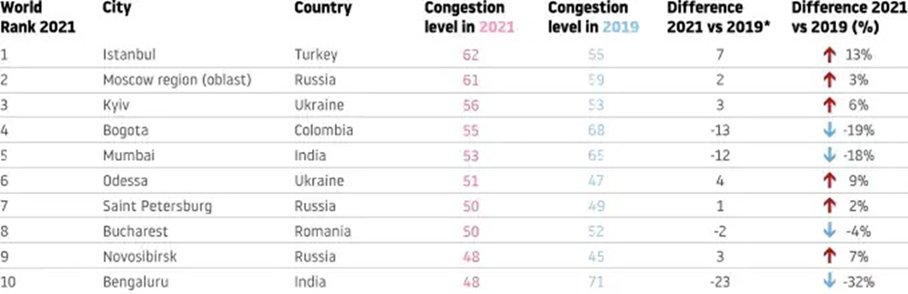
This project will tackle the problem by predicting the volume of traffic congestion by using Artificial Intelligence and Machine Learning.
Traffic congestion prediction provides the authorities with the required time to plan in the allocation of resources to make the journey smooth for travellers.
Results of the study conducted by TomTom traffic index in 2021.

Slide 12
Proposed Method
Traffic is influenced by many factors, and you should consider all of them to make accurate predictions. So, there are several main groups of data that you’ll have to obtain.
Mapping Data :First of all, we need to have a detailed map with road networks and related attributes. Connecting to such global mapping data providers as Google Maps, TomTom, HERE, or OSM is a great way to obtain complete and up-to-date information.
Traffic information. Then, we'll have to collect both historical and current traffic-related information such as the number of vehicles passing at a certain point, their speed, and type (trucks, light vehicles, etc.). Devices used to collect this data are

Slide 13
loop detectors, cameras, weigh in motion sensors, and radars or other sensor technologies.
Fortunately, we don’t have to install these devices all over the place on our own . It’s easier to get this information from the providers mentioned above that gather data from a system of sensors, diverse third-party sources, or use GPS probe data.
Weather information. Weather data (historical, current, and forecasted) is also necessary asnatural conditions impact the road situation and driving speed. There are lots of weather data providers you can connect to — such as Open Weather or Tomorrow.io.

Slide 14

DATA NEEDED FOR TRAFFIC PREDECTION
MAPPING DATA
TRAFFIC DATA
OTHER EXTERNAL DATA
WEATHER DATA

Slide 15
Statistical approach
Statistical methods allow you to identify traffic patterns at a different scale: during the day, on different days of the week, seasonal, etc. They are usually easier, faster, and cheaper to implement than machine learning ones. However, they are less accurate since they can’t process as much multivariate data.
Machine learning approach
Machine learning (ML) allows you to create predictive models that consider large masses of heterogeneous data from different sources.
Deep learning approach
Deep learning (DL) methods have proved highly effective in predicting road traffic in comparison to ML or statistical techniques, consistently showing about 90 percent forecasting accuracy and higher. Deep learning algorithms are based on neural networks.
Neural networks (NN) or artificial neural networks (ANN) consist of interconnected nodes (neurons) that are arranged in two or more layers and are designed to function similar to the human brain.

Slide 16
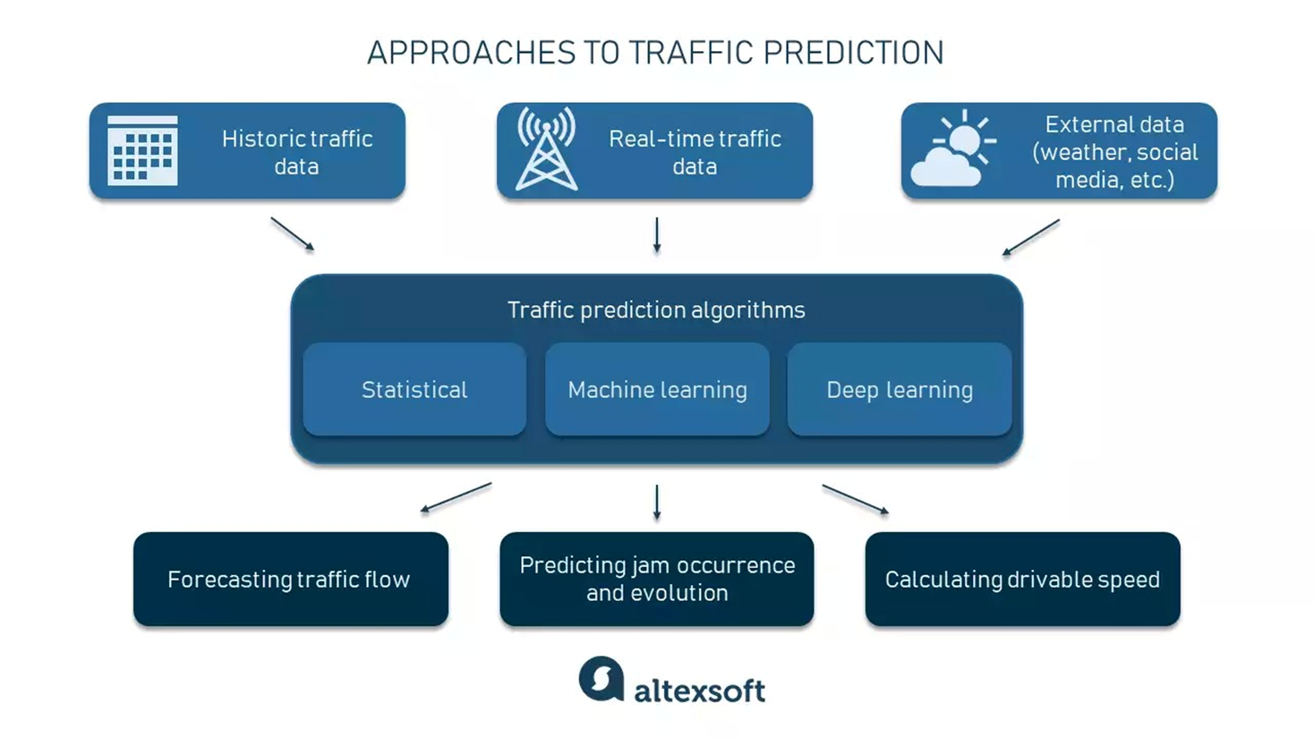

Slide 17
THANKS

